Slide 1
COMP 301 Analysis of Algorithms
Probabilistic Analysis and Randomized Algorithms

Slide 2
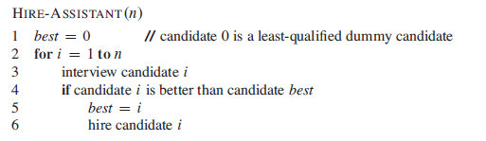
The Hiring Problem
Focus on interview and hiring costs
Worst-case analysis

Slide 3
Probabilistic Analysis
Need to know or assume the distribution of inputs
Under equal probability of ranking for applicants n! permutations can be assumed to have equal probability
Uniform random permutation

Slide 4
Randomized Algorithms
An algorithm is randomized if its behavior is determined by its input and values produced by a random number generator
RANDOM(a,b)

Slide 5
Analyzing Randomized Algorithms
Take expectation of running time over the distribution of values returned by the random number generator
Expected running time

Slide 6

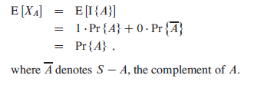


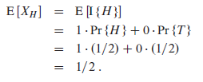

Indicator Random Variables

Slide 7
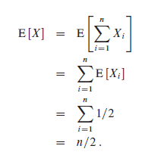
Example Coin Flipping
Flip a coin n times and find the expected number of heads

Slide 8


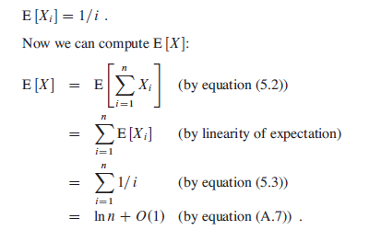
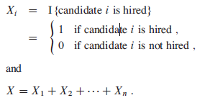
Analyzing Hiring Problem
Compare it to worst case

Slide 9
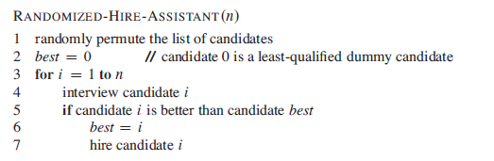
Randomized Algorithms

Slide 10
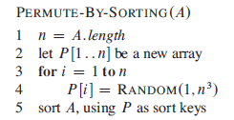
Randomly Permuting Arrays
Comparison sort
Merge sort
Possible to do it

Slide 11

Randomly Permuting Arrays

Slide 12
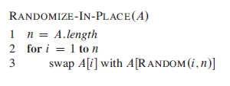
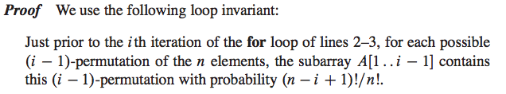
Randomly Permuting Arrays

